Slide 1
Southern California Edison’s (SCE)
WDAT Queue Cluster 16
An Introduction to SCE’s Cluster Study Process

Slide 2
Purpose of Presentation
This self-guided presentation is to help provide an understanding of SCE's Cluster Study Process under the Wholesale Distribution Access Tariff (WDAT) Resource Interconnection Procedures (RIP), specifically how to properly submit an Interconnection Request.
Should there be discrepancies between this presentation and SCE’s tariffs, SCE’s tariffs and interconnection documents prevail.

Slide 3
Overview
QC 16 Updates
Agreement Types
Interconnection Request Information
  IR Checklist
  Submittal of Interconnection Requests and Deposits
  Interconnection Request Forms
  Required Technical Documents
Smart Inverter Requirements
Demonstrating Site Exclusivity
  Sizing Your Generating Facility
  Distribution Circuits
  Grid Voltages
Deliverability
Charging Distribution Service for Storage projects
  WDAT Amendment Energy Storage
Wrap-Up
  Quick Tips
  Important Dates & Links
  Questions - Via Email
Appendix
  Acronym List
  Resources

Slide 4
What's new for QC16?
Here are some of the changes and updates for QC16:
WDAT amendment filed 7/10/2026 in ER26-3134, with a requested effective date of 9/9/2026. The amendment proposes to align with Interconnection Process Enhancement (IPE)-related filings submitted by CAISO with FERC since 2024, including IPE 5.0 filing submitted 6/5/2026 and currently pending before FERC. The changes to the WDAT Include:
The annual Cluster Request Window will move to 9/11-9/25 from 10/1-10/15, to align with PG&E and SDG&E and accommodate the CAISO’s deliverability application process.
All Cluster Interconnection Customers seeking deliverability in a Deliverable Zone must complete an application to CAISO during its annual Cluster Application Window, which remains 10/1-10/15. The deliverability application must be completed via CAISO’s online application tool, Grid Resource Interconnection Portal (GRIP).
WDAT Interconnection Customers are not eligible for the Merchant Zone option under CAISO’s new deliverability process and those customers seeking Energy Only deliverability status are not required to apply to CAISO.
Once a Deliverability option is selected, an Interconnection Customer may not change that selection. An opportunity to make a permitted modification regarding deliverability prior to the Cluster Study has been removed from the WDAT Resource Interconnection Process (RIP) and the timeline to discuss an alternate POI has been modified.
CAISO will conduct its scoring process for deliverability during the first part of the 90-day Customer Engagement Window, which opens 10/16/2026. Only those WDAT Interconnection Requests (IRs) that satisfy this process will proceed to the Cluster Study; all others will be deemed withdrawn by SCE.
The initial Commercial Readiness Deposit (CRD) will now be due before the end of the Customer Engagement Window, i.e., after IR validation.
SCE has added a requirement that Interconnection Customers seeking to extend the Commercial Operation Date (COD) beyond 7 years must comply with CAISO’s Commercial Viability Criteria (RIP Section 3.9), along with Shared Network Upgrades requirements that align with CAISO (RIP Section 9.4)

Slide 5
What's new for QC16? contd.
Additional non-IPE-related changes include:
All WDAT IRs must be submitted via SCE’s online application tool, Grid Interconnection Processing Tool (GIPT).
The study deposit for a modification request will increase from $10K to $25K; this increased deposit can also be used to pay for SCE’s cost amending an agreement pursuant to a completed Interconnection Customer-driven modification assessment study report.
After submittal of the initial CRD, any increases in the CRD will be based on Distribution Upgrades (DU) costs rather than Network Upgrade costs. The GIA Deposit will also be based on DU costs.
Withdrawal Penalty calculations have been modified to reflect DU costs rather than Network Upgrades costs. In addition, any remaining Withdrawal Penalty funds, after being allocated towards study costs and increased DU costs in the same Cluster, will be returned to withdrawn Interconnection Customers in that Cluster.
A project’s maximum cost responsibility will include Other Potential Network Upgrades scope and cost, i.e., triggered by an earlier-queued project and not included in an executed GIA. [RIP 4.10.7.3]
A new RIP Section 3.17 regarding transfers from Rule 21 to WDAT.
Added specifications regarding the withdrawal timeline for Fast Track IRs.
Revised the Wholesale Load application and study process requirements in WDAT Sections 15 and 16.

Slide 6
Agreement Types
Wholesale Distribution Access Tariff (WDAT) Interconnection Agreement (IA)
Allows Developers to interconnect their project to SCE’s distribution system
Wholesale Distribution Service Agreement (DSA)
Allows Developers to transmit electrons through SCE’s distribution system
Power Procurement Agreement (PPA)
- Selling your power to a buyer (SCE, PG&E, SDG&E, etc.)
- Not included as part of this presentation

Slide 7
WDAT Interconnection Request Checklist
Completed Interconnection Request (Appendix 1 to GIP) via GIPT, with all requested technical data
  Single-Line Electrical Diagram
  Site/Plot Plan Diagram
  Proof of Site Exclusivity, or In-Lieu Deposit ($100,000 <20 MW or $250,000 >20 MW)
  Diagrams, manufacturer’s data, and written descriptions of the generating facilities
  Distribution Service information (Interconnection Request Section 10)
  Storage System information required for storage systems (Interconnection Request Section 11 in Attachment A)
Study Deposit: $50,000 plus $1,000/MW, up to $250,000 maximum, and $20,000 for projects that include a request for Firm Charging Distribution Service. Projects with a combination of Firm Charging Distribution Service and As-Available Charging Distribution service require an additional $20,000.
  Submit your Study Deposits separately by following the payment instructions

Slide 8
  Submitting Deposits
Cluster Study Process Deposit
  $50,000 plus $1,000 per MW of electrical output of the generating facility (or the increase in electrical output of the generating facility) rounded up to the nearest whole MW, up to a max of $250,000, and
  $20,000 for projects that include a request for Firm Charging Distribution Service.
  Projects with a combination of Firm Charging Distribution Service and As-Available Charging Distribution service require an additional $20,000.
Site Exclusivity Deposit (optional) - In lieu of providing proof of Site Exclusivity, a Site Exclusivity Deposit may be submitted:
  $100,000 for a Small Generating Facility (<20 MW) or
  $250,000 for a Large Generating Facility
Please don’t send checks with your application documents. Checks need to go directly to the SCE Accounts Receivable department. Instructions will be provided via GIPT invoices or if you send a Request for Payment Instructions.
  GIPT will generate application invoices real-time based on the Facility size listed in the "Facility Information" section, it will also provide invoices based on your firm charging selection (as applicable for energy storage) and your Site Exclusivity selection. Please select “other” for the payor information, and after you click “Generate Invoice” please click “Save”. The generated invoices will include mailing or wiring/ACH instructions.
  The instructions will indicate how to send the payment to SCE’s Accounts Receivable separately from the documents. Click for online link to: Request for Payment Instructions
  Due to SCE’s current teleworking environment, it is preferred to wire the money as there are limited persons physically working in the office to accept and track payment.
  After submitting payment, send us an email providing wire confirmation or check tracking number to: Grid.Interconnections@sce.com

Slide 9
Interconnection Request (IR) Forms
WDAT Distribution Interconnections
WDAT IR form (Appendix 1 to GIP), Payment Instructions can be found on the SCE portal:
  www.SCE.com > Your Business > Generating Your Own Power > Grid Interconnections > Wholesale Distribution Access Tariff (WDAT) > Initiating a Request for Interconnection Under The GIP > Appendix 1 – Interconnection Request for a Generating Facility
  Online Portal Link: Grid Interconnection Processing Tool (this will generate a PDF upon submittal which is Revised for QC 16 applications)
    A WDAT User Guide and Training videos are available to help new users
    Please register in advance of the opening of the window so that we can address any issues early on.,
_____________________________________________________________________________________________________________________________
CAISO Transmission Interconnections
CAISO Interconnection Request details:
  Online Link: CAISO Interconnection Request details
(Note: SCE does not accept CAISO Interconnection Requests)

Slide 10
Required Technical Documents
Single Line Diagram
  Generators (number of units, size, manufacturer, voltage)
  Transformers (kVA rating, winding configuration, impedance, kVA base)
  Switches/disconnects of the proposed interconnection
  Protection Devices and Circuit Breakers
  Meters
Plot Plan
  Shows the buildings, utility runs, equipment layout, the position of roads, and other constructions of an existing or proposed project site at a defined scale
  Sample SLDs & Plot Plans
Site Drawing
  Shows generator project location and gen tie (if applicable)
  Point of Interconnection with the SCE’s Distribution System, including GPS coordinates
  GPS coordinates of the Customer’s protective device
  To be provided in (.kmz) file
Detailed technical data for equipment
  Manufacturer specifications and diagrams on:
    Transformers
    Inverters
      UL1741 & UL 1741 SA Certification
      Short Circuit Duty Contribution Information
    Power system controls

Slide 11
Smart Inverter Requirements
Pursuant to the CPUC resolutions E-4920, E-4898 and E-5000 new interconnection requests utilizing smart inverters will require the following:
  UL1741 SA - Implementation effective September 9, 2017
  Reactive Power Priority (RPP) – Effective July 25, 2018
  Function 5 & 6 (Frequency/Watt & Volt/Watt) –Effective February 22, 2019
  Function SA17 and SA18 (Disconnect and Reconnect Command & Limit Maximum Active Power) – Effective June 22, 2020
It is the responsibility of the customer/developer to purchase equipment which meets all requirements adopted in Resolutions E-4920 , E-4898 and E-5000.
The California Energy Commission (CEC) manages the list of eligible inverter equipment. For more information, visit the CPUC dedicated Rule 21 Smart Inverter Working Group website or an email may be sent to InterconnectionQA@sce.com

Slide 12
Smart Inverter Requirements
IEEE Std.1547 is relevant only to distribution connected resources
  Does not apply to resources connected to the transmission or subtransmission system
  Numerous changes to the original 2003 standard
While inverter manufactures may need to meet the requirements of IEEE 1547, BES resources are still subject to NERC Reliability Standards
Existing inverters have been historically designed with distribution requirements in mind
  While appropriate for distribution resources, this can lead to momentary cessation on the BPS which is not the intent
  Investigations such as those into the Blue Cut Fire suggest that one root cause may have been the misapplication of IEEE 1547
Further information regarding IEEE Std.1547 and NERC Guidelines related to inverter based resources can be found at:
https://standards.ieee.org/standard/1547-2018.html
https://www.nerc.com/comm/OC_Reliability_Guidelines_DL/Inverter-Based_Resource_Performance_Guideline.pdf

Slide 13
Demonstrating Site Exclusivity
Read and follow SCE’s Guidelines for Demonstration of Site Exclusivity: Site Exclusivity Guidelines
Reminders:
  The Assessor’s Parcel Number (APN) should be listed on both the Site Exclusivity Documentation and the IR form. Please include the project’s GPS coordinates and acreage.
  In lieu of providing proof of Site Exclusivity, a Site Exclusivity Deposit may be submitted:
    $100,000 for a Small Generating Facility (<20 MW) or
    $250,000 for a Large Generating Facility (>20 MW)
  If site exclusivity documentation is not ready, SCE encourages the Site Exclusivity Deposit be submitted
    SCE pays interest from date of receipt and there is no risk missing the cluster deadlines

Slide 14
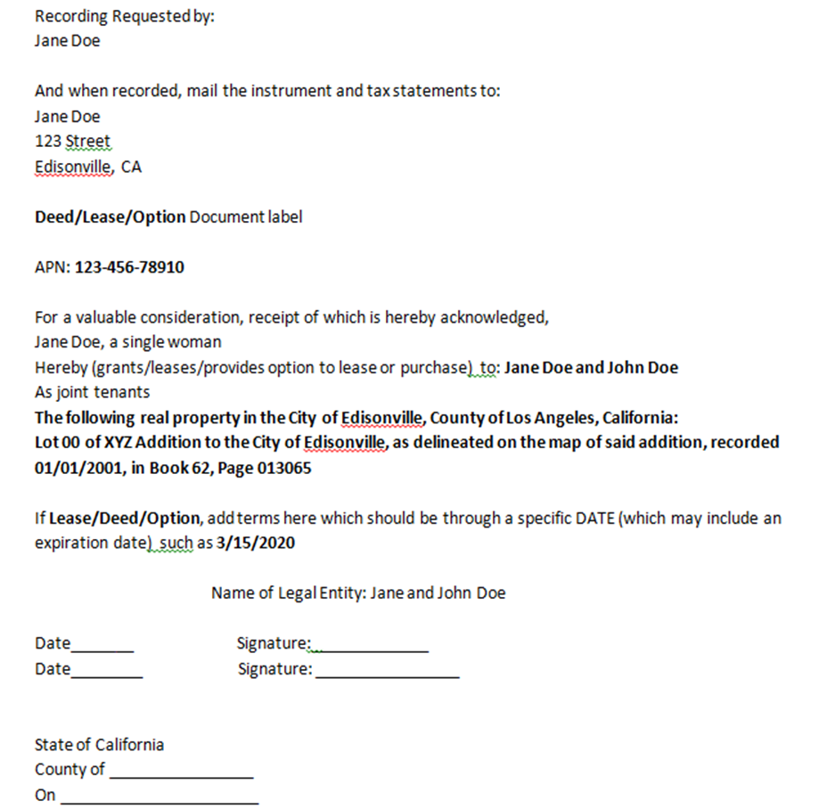
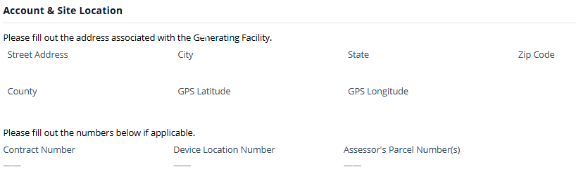
APN Needs to Appear on Both Documents
Sample Site Exclusivity Document
Interconnection Request Form
Please put the Assessor’s Parcel Number (APN) on the Interconnection Request form in the GIPT Section Project and Contact Information
signature
signature

Slide 15
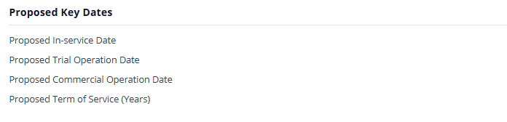
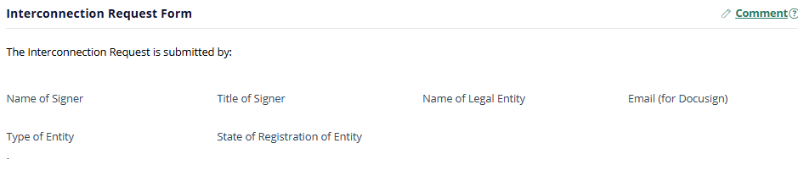
Lease/Option Date Must be Through COD
Sample Site Exclusivity Document
Interconnection Request Form
The term of the site exclusivity document should be, at a minimum, through the Commercial Operation Date, GIPT section Facility Information
Interconnection Request Form
signature
signature
The legal name of the Interconnection Customer on GIPT section Signatories

Slide 16
Guidelines for Sizing Your Generating Facility
During the Scoping Meeting, Distribution Engineering will provide system conditions and any known limitations that can assist customers to appropriately size their project.
Allowable maximum Generation is subject to change based on queue generation and reliability constraints
Sizes may differ based on adding energy storage due to Circuit/Substation loading

Slide 17

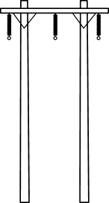
Grid Voltages – WDAT vs. TOT
SCE’s distribution system = SCE controlled = WDAT
  4 kV – 16 kV: residential circuits
  16 kV – 33 kV: city/industrial circuits
  55 kV – 115 kV: sub-transmission
(16 kV
Pole)
(66 kV
Pole)
(115 kV
Pole)
CAISO Controlled Line | kV
Control-Silver Peak "A" | 55
Control-Silver Peak "C" | 55
Antelope - Neenach | 66
Bailey - Neenach | 66
Control-Haiwee-Inyokern | 115
Control-Coso-Haiwee-Inyokern | 115
Inyokern-Kramer-Randsburg No.1 | 115
Inyokern-Kramer-Randsburg No.3 | 115
Ivanpah-Baker-Coolwater-Dunn Siding-Mountain Pass | 115
Kramer-Roadway | 115
Kramer-Victor | 115
Roadway-Victor | 115
CAISO Controlled Bus | kV
Control | 55
Antelope | 66
Bailey | 66
Neenach | 66
Coolwater | 115
Control | 115
Inyokern | 115
Ivanpah | 115
Kramer | 115
Roadway | 115
Tortilla | 115
Victor | 115

Slide 18


Grid Voltages – WDAT vs. TOT
SCE’s transmission system = CAISO & SCE controlled
  220 kV & 500 kV jurisdiction fall under applicability of the CAISO Tariff
    Interconnection Requests must be sent to the CAISO
  Majority of the 66 kV and 115 kV system is under SCE control
    Some exceptions do apply
    If Interconnection Request is to the CAISO controlled grid, the project must apply to the CAISO and not SCE
Mostly SCE, Some CAISO
CAISO
(66 kV
Pole)
(115 kV
Pole)
(220 kV
Tower)
(500 kV Tower)

Slide 19
CAISO/WDAT Deliverability Options
All Cluster Interconnection Customers seeking deliverability in a Deliverable Zone must complete an application to CAISO during its annual Cluster Application Window, which remains 10/1-10/15. The deliverability application must be completed via CAISO’s online application tool, Grid Resource Interconnection Portal (GRIP). WDAT Interconnection Customers are not eligible for the Merchant Zone option under CAISO’s new deliverability process and those customers seeking Energy Only deliverability status are not required to apply to CAISO.
Deliverability: Defined as the annual Net Qualifying Capacity of a Generating Facility, as verified through a Deliverability Assessment and measured in MW, which specifies the amount of resource adequacy capacity the Generating Facility is eligible to provide.
You must select one:
Energy Only Deliverability Status
  Avoids cost of delivery network upgrades
  Cannot qualify as a Resource Adequacy resource in PPA
Full Capacity Deliverability Status
  Allocated delivery network upgrades in interconnection studies
  Can qualify as a Resource Adequacy resource in PPA
Partial Capacity Deliverability Status
  Allocated delivery network upgrades in interconnection studies
  Can qualify as a Resource Adequacy resource in PPA
All options/selections/choices are subject to curtailment
Deliverability evaluations are performed by the California Independent System Operator. Any charges incurred for these evaluations will be applied to your study deposit.

Slide 20
Charging Distribution Service for Storage projects
An Interconnection Customer ("IC") can choose one of the following: 1) As-Available Charging Distribution Service only; 2) Firm Charging Distribution Service only; 3) a combination of As-Available Charging Distribution Service and Firm Charging Distribution Service; 4) “None” (if the storage component will not charge from the grid, i.e., from onsite generation).
As-Available customers will pay a new Energy Charge Rate and a new monthly Customer Charge, unless exempted. (For further information, please see FERC Docket No. ER19-2505).
As-Available Charging Distribution Service is based on availability on the existing Distribution System and is subject to curtailment before retail load, Wholesale Distribution Load, and Firm Charging Capacity.
Firm Charging Distribution Service has the same curtailment priority as retail load and Wholesale Distribution Load, except during abnormal or emergency events.
Firm Charging Distribution Service customers will pay ”Higher-of-Facilities” costs or a Demand Charge Rate based on average embedded cost of distribution grid (only one, not both).
A Firm Charging Distribution Service customer paying the Demand Charge Rate (i.e., not subject to funding Higher-of-Facilities) will up-front finance the costs of Distribution Upgrades and those costs will then be returned to the customer upon COD, over a five-year period with levelized quarterly payments plus interest.

Slide 21
Quick Tips
Review our FAQ → WDAT Processes
If a deficiency notice is received for the IR, please respond quickly, and only revise applicable sections as requested by SCE.
Apply Early!
  The sooner an application is submitted, the sooner a response can be provided with correction requests, if necessary.
Deposit must be submitted to SCE Accounts Receivable by the close of the window.
The completed Interconnection Request (Appendix 1 to RIP) must be received by the processing team by the close of the window with all requested technical data to be considered a complete package.
FINAL SUBMITTAL DATE/Close of the WDAT Cluster window = Friday, September 25th, 2026.

Slide 22
Important Dates/Milestones
*Due Dates | Milestones
Friday, September 25, 2026 | Last day to submit QC16 WDAT Cluster Applications. PLEASE do not wait until the last day!
Friday, September 25, 2026 | Latest/last day for the IC to submit information which constitutes a valid request [See RIP Attachment M Section 4.3.3 and 4.3.3.2]*.
Thursday, October 15, 2026 | Last day to submit CAISO Deliverability Application for WDAT Projects in a Deliverable Zone seeking Deliverability. PLEASE do not wait until the last day!**
October 16, 2026 – January 13, 2027 | Customer Engagement Window [90 Calendar Day period, See RIP Attachment M Section 4.4]
Prior to January 13, 2027 | Scoping Meeting to be held during the Customer Engagement Window
January 13, 2027 | Execute Cluster Study Agreement (no later the close of the Customer Engagement Window)
January 14, 2027 | Start Cluster Study
~June 2027 | Publish Cluster Study Report (150 CD after close of the Customer Engagement Window)***
~June/July 2027 | Hold Cluster Study Results Meetings
~July 2027 | Start Cluster Restudy
If Interconnection Customer fails to satisfy the requirements in RIP Section 4.3.3.2, the application will be withdrawn.
** SCE will validate accuracy of Deliverability Application. It is encouraged to submit early to allow time to cure any identified deficiency(ies).
*** Dates shown above will shift accordingly for storage projects that choose Firm Charging Distribution Service.

Slide 23
Submittal of WDAT QC16 Interconnection Requests
An Interconnection Customer shall submit to Distribution Provider an Interconnection Request in the form of Appendix 1 for processing under the Cluster Study Process. Interconnection Request and required fee and deposits shall be submitted via Distribution Provider’s online application via the following:
GIPT – Online via GIPT: https://gridinterconnection.sce.com
NOTE: Interconnection Requests submitted via any other means will not be accepted.

Slide 24
Important Links
  Website
  SCE's WDAT
  SCE's Energy Procurement
Forms
  WDAT Interconnection Request (Appendix 1, Attachment A, & request for payment instructions)
  CAISO Interconnection Request Details
Guidelines / Examples / Questions
  Site Exclusivity Guidelines
  Distribution Resources Plan External Portal (DRPEP)
  For questions on WDAT Interconnection Issues: InterconnectionQA@sce.com
  For questions on TOT Interconnection issues: IRinfo@caiso.com
  CAISO Interconnection Requests (Including Prohibited Project Names)

Slide 25

Have additional Questions?
  Please submit questions via email to:
  InterconnectionQA@sce.com

Slide 26
Acronym List For Presentation

Slide 27
APN | Assessor's Parcel Number | IA | Interconnection Agreement
BES | Bulk Electric System | IC | Interconnection Customer
BPS | Bulk Power System | IEEE | Institute of Electrical and Electronics Engineers
BESS | Battery Energy Storage System | IR | Interconnection Request
CAISO | The California Independent System Operator Corporation | MW | Megawatt
CEC | California Energy Commission | NERC | The North American Electric Reliability Corporation
COD | Commercial Operation Date | PPA | Power Procurement Agreement
CPUC | California Public Utilities Commission | QC | Queue Cluster
DRPEP | Distribution Resources Plan External Portal | RPP | Reactive Power Priority
DSA | Distribution Service Agreement | SCE | Southern California Edison
FAQ | Frequently Asked Questions | SLD | Single Line Diagram
GIA | Generator Interconnection Agreement | TOT | Transmission Owner Tariff
GIP | Generator Interconnection Procedures | UL | Underwriters Laboratories
GPS | Global Positioning System | WDAT | Wholesale Distribution Access Tariff

Slide 28
In lieu of the previously provided PDF sample, we are providing additional resources to help complete the online form.
WDAT Applications must be submitted via our online tool, Grid Interconnection Processing Tool: https://gridinterconnection.sce.com/prweb?AppName=GIPT
A WDAT User Guide contains information about the application, and Training videos are available to help new users.
This is a new tool so please see our Frequently Asked Questions for more information: https://edisonintl.sharepoint.com/:b:/t/Public/Misc/ESenxULxRvdBpqq5yzf5YREBBFuQdBWo6i7YVMdMGPIlfQ?e=n7rHN5

