Slide 1
Annual DA Lottery Process Submission Tips

Slide 2
Submission Reminders
A direct access cap offer will be sent to customers on the 2024 waiting list (created for the June 2023 lottery) in August. There will be fifteen (15) business days for the customer to accept or decline the DA transfer.
Lottery starts on Monday 6/12/23 at 9:00 am and ends on Friday 6/16/23 at 5:00 pm
For Multiple Submission Click On Multiple Submission Spreadsheet.xlsx

Slide 3
How to Participate
CISR Form 14-796 must be completed
6-Month Advance Notice to Transfer Account to DA Form 14-793 must be completed
Email danotices@sce.com 6/12/23-6/16/23

Slide 4
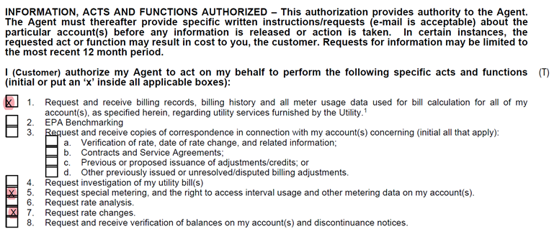
Completing CISRS: Tips
If you submit a CISR, and select 1, 5, & 7, you will receive a file with interval usage and billing history before August 2023. The following year's load offering will not require another CISR, so you can request updated interval usage and billing.

Slide 5
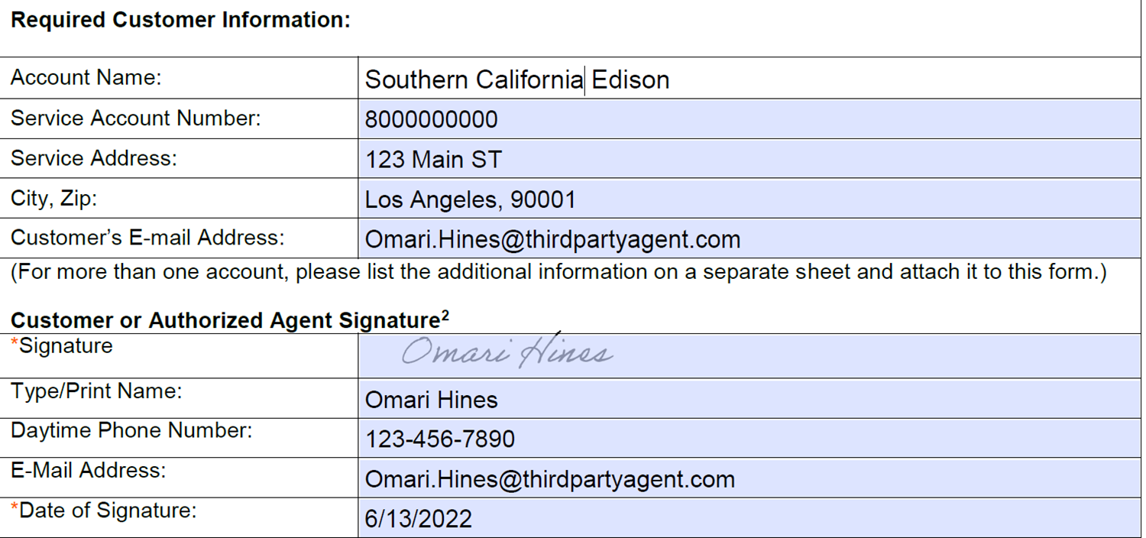
6-Month Notice: Tip#1
The SCE Form 14-793 must be signed and dated.
Please Note: All 6-Month Notices that are signed by an ESP or a consultant must have a CISR on file.

Slide 6
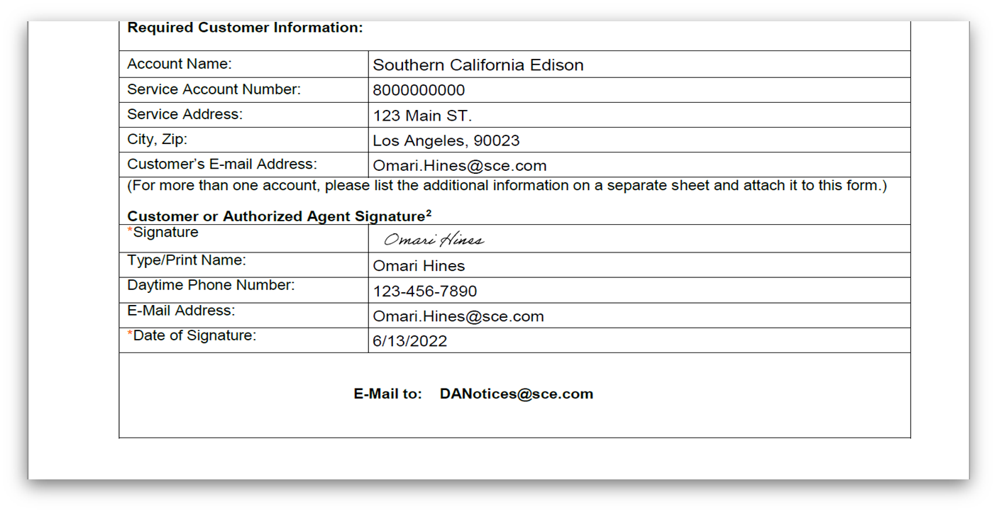
6-Month Notice: Tip#2
Fill out the fillable form so that SCE can accurately record your submission.
Please Note: No CISR is required when the customer signs the Six-Month Advance Notice

Slide 7
6-Month Notice: Tip#3
When you have multiple accounts, use the Multiple Submission Spreadsheet

Slide 8
6-Month Notice: Tip#4
When using the Six-Month Notice Spreadsheet, you must provide the service account with the leading prefix 80 on the customer’s bill

Slide 9
6-Month Notice: Tip#5
Please note that SCE is looking for the name on your monthly bill. Submissions with incorrect names will be sent back for corrections.

Slide 10
6-Month Notice Submission Tips Recap:
It is required that all 6-Month Notices signed by the 3rd Party be accompanied by a CISR.
A 6-Month Notice signed by the customer doesn't require an active CISR
For load offerings, complete Form 14-796 with 1, 5, and 7 if you require customer data
You will need to complete the Multiple Submission Spreadsheet if you are submitting multiple submissions for the same customer
It is mandatory to include the Service Account Number with an 80 at the beginning of the number in all submissions. Since service account numbers change, please request the most current statement from the customer.
Last but not least, make sure the name on the spreadsheet or notice matches the name on the SCE bill

Slide 11
Reasons for the 5-Day Correction
If SCE finds incorrect information in the Six-Month Notice or the Multiple Submission Spreadsheet template, SCE will contact the submitter to correct the error.
Unreadable Submissions or file formats
Missing Signature
Missing Date
Invalid Name
Invalid Service Account Number(s)
Service Accounts that do not match the Six-Month Notice Name
Closed Accounts
Currently on DA
Signed Six-Month Notices by ESPs or Consultants with no Valid CISR
Invalid Rate

Slide 12
2024 Direct Access Waitlist#
After completing the review period and correcting all deficiencies, SCE will use a randomizer tool to select a random number for each eligible Six-Month Notice submission.
Submitters of Six-Month Notices will be notified by SCE electronically by August 14, 2023, of their 2024 DA Wait List number.

Slide 13
SCE Forms and Support
Form 14-793, Six-Month Advance Notice to Transfer to Direct Access
Form 14-793, Six-Month Advance Notice to Transfer to Direct Access
Sample of 14-793 completed
Sample of 14-793 completed
Multiple Submission Spreadsheet
Multiple Submission Spreadsheet
Sample Excel for Multiple Submission Spreadsheets
Multiple Submission Spreadsheets
Form 14-796, Authorization to Receive Customer Information or Act on a Customer's Behalf Form
Form 14-796, Authorization to Receive Customer Information or Act on a Customer's Behalf Form

Slide 14
Partial Reopening of Direct Access
626-815-5609
DANotices@SCE.com
Send us an email with any questions regarding DA Participation
Contact us directly for support
Visit for additional Direct Access Program details

